Slide 1

Principles of Programming Language
Electronics and Computer Engineering

Slide 2

Unit –I Programming Language Syntax and Semantics
Electronics and Computer Engineering

Slide 3
Software Development Process
Requirements Analysis and Specifications
Software Design
Implementation
Verification and Validation
Maintenance
Waterfall Model

Slide 4
Requirement analysis and Specification
Identify and document the exact requirements for the system
1
Requirements developed jointly by requirements and software developers
2
Success of system – comparison between needs and actual
3
Requirement documents does not specify how the system is going to meet its requirements
4

Slide 5
Software Design
As per the requirement document, software developers design the software system
Result of this phase is identified and design the modules as per the requirements of system
Also find out the how they interface
Provide the documents about modules specifications interfaces
Its can also help to choose programming language to be used in system development

Slide 6
Implementation (Coding)
As per the design specification software developers implement the system.
Goal of these step is to choose how, among the many possible ways, the system shall be coded to meet the design specifications
what for
Requirement Phase ---------->Design Phase (design is the how)
what for
Design Phase ----------------> Implementation Phase (How)

Slide 7

Verification and Validation Phase
Access the quality of the implemented system
In every phase of development process or implementation phase its work
To ensure that intermediate deliverable is satisfy their objectives
“Are we building the product, right ?”
“Are we building the right product?”

Slide 8
Testing
Manual Testing: Involves human testers executing test cases without automation, relying on their knowledge and judgment.
Automated Testing: Uses tools and scripts to automatically execute test cases and compare actual outcomes with expected results.
Unit Testing: Focuses on individual components (functions, methods) of the software.
Integration Testing: Tests interactions between different software components.
System Testing: Validates the complete system to ensure all components work together.
Acceptance Testing: Confirms the software meets the user requirements and is ready for release.
Regression Testing: Ensures that new code changes don't introduce bugs in existing functionality.

Slide 9
Testing
Performance Testing: Assesses the speed, responsiveness, and stability under various conditions.
1
Security Testing: Checks for vulnerabilities, security flaws, and data protection issues.
2
Usability Testing: Focuses on the user experience, ensuring the software is intuitive and easy to use.
3
Compatibility Testing: Verifies that the software works across different devices, browsers, or operating systems.
4

Slide 10
Testing Tools
JUnit / NUnit / TestNG: Frameworks for unit testing, especially in Java and .NET environments.
Selenium: A widely used tool for automated web application testing across different browsers.
Appium: Used for automated mobile application testing (Android and iOS).
Postman: A tool for API testing, used for testing RESTful APIs and web services.
JMeter: A performance testing tool primarily used for load testing web applications and services.
Cucumber: A tool for behavior-driven development (BDD), where tests are written in natural language.

Slide 11
Maintenance
Handle the existing system with adding new features
Improve the existing one
Combability with operating system

Slide 12
Languages & Software Development Environments
To increase the productivity of software development, computer support is needed for all of its development phases.
Environment is an integrated set of tools and techniques
Environment is used in all phases of software development
Different environments tools are available in the market

Slide 13
Development Environment
Purpose: Where developers write, debug, and test their code locally.
Characteristics:
Isolated setup for individual developers.
Includes IDEs, local servers, and databases.
Often uses mock data or lightweight services.
Examples:
Local setups using tools like Visual Studio, IntelliJ IDEA, or Eclipse.
Local Docker containers for running services.

Slide 14
Integration Environment
Purpose: Combines code from multiple developers and tests its integration.
Characteristics:
Focuses on detecting integration issues between different components or modules.
Continuous Integration (CI) pipelines often automate this stage.
Examples: Jenkins, GitLab CI/CD pipelines running integration tests.

Slide 15
Testing/QA Environment
Purpose: Dedicated environment for quality assurance and rigorous testing.
Characteristics:
Mimics production-like conditions but is isolated from production.
Used for functional, regression, performance, and security testing.
Often includes test data that simulates real-world usage.
Tools Used: Selenium, JMeter, Postman, etc.

Slide 16
Build/Release Environment
Purpose: Used to compile code and prepare builds for deployment.
Characteristics:
Generates executable code from source code.
Often integrated with CI/CD pipelines.
Tools Used: Maven, Gradle, Jenkins, GitLab CI.
Workflow Across Environments
Development → Integration → QA/Testing → Staging → Production

Slide 17
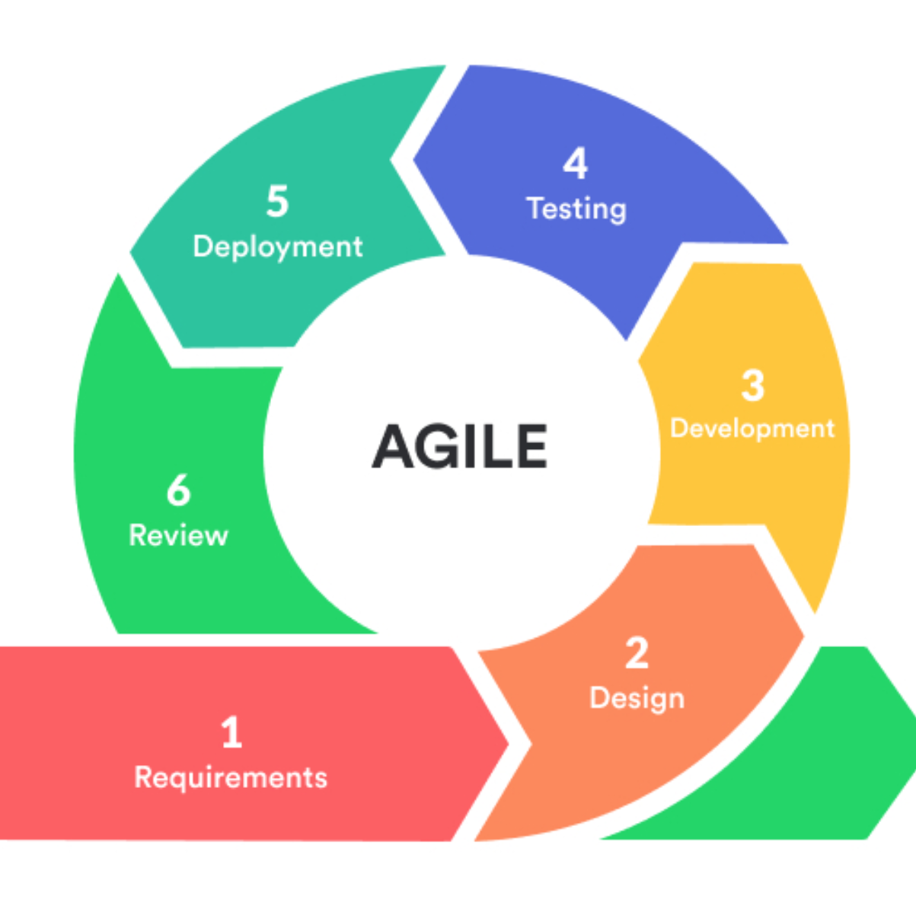
Agile Methodology

Slide 18
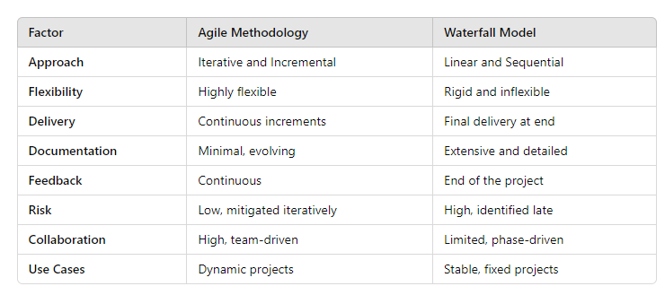

Slide 19
Software Design Methods
Design method is a guidelines for producing a design
Methods:-
Structured Design
Top-Down Design
Object Oriented Design
Design approach decompose the system or requirements in different logical components
Important => Relation between software design methods and programming language
Programming Style => Programming Paradigm

Slide 20
Programming Paradigm
It is fundamental style or approach to programming that provides a way to structure and organize code.
It represents a set of principles, concepts, and methods that dictate how programs are constructed, organized, and executed.

Slide 21
1. Procedural Programming
Focus: Sequence of instructions and procedures.
Concepts: Functions, loops, and conditionals.
Structure: Code is organized into procedures (functions) that operate on data.
Example Languages: C, Pascal, Fortran.
Use Case: Simple programs, where the flow of execution is clear and sequential.

Slide 22
2. Object-Oriented Programming (OOP)
Focus: Objects and their interactions.
Concepts: Classes, objects, inheritance, encapsulation, and polymorphism.
Structure: Code is organized around "objects" that represent real-world entities and their behaviors.
Example Languages: Java, Python, C++, C#.
Use Case: Complex systems where modularity, reusability, and scalability are important.

Slide 23
3. Functional Programming
Focus: Mathematical functions and immutability.
Concepts: Pure functions, higher-order functions, recursion, and avoiding side effects.
Structure: Programs are composed of functions that take inputs and produce outputs without altering state.
Example Languages: Haskell, Scala, Lisp, Erlang, F#.
Use Case: Scenarios requiring parallel processing, data analysis, or predictable outcomes.

Slide 24
4. Logic Programming
Focus: Facts and rules to derive conclusions.
Concepts: Uses logical statements to express facts and rules.
Structure: The program queries a knowledge base and deduces results based on logic.
Example Languages: Prolog, Datalog.
Use Case: Artificial intelligence, problem-solving, and knowledge representation.

Slide 25
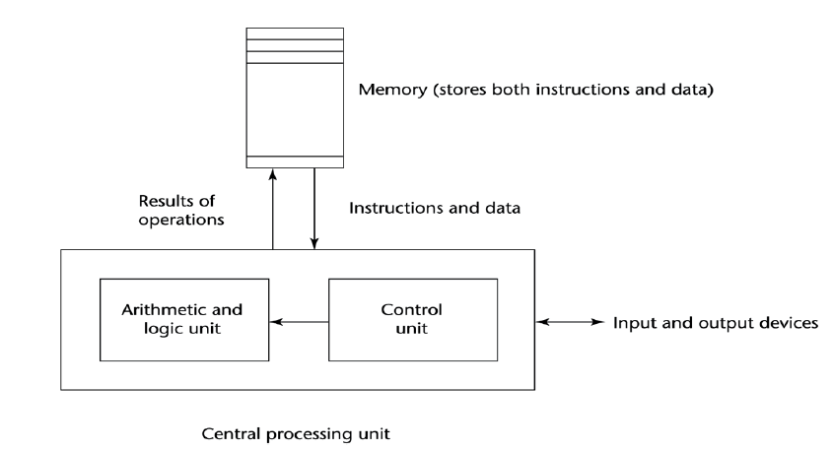
Computer Architecture (Von Neumann Architecture)
Impact of Machine Architectures

Slide 26
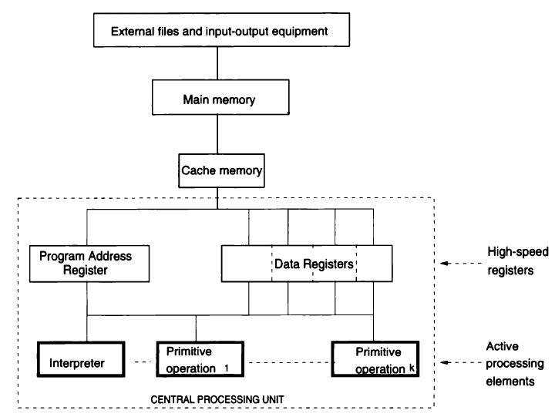

Slide 27
Computer Components
A Computer consists of six major components that correspond closely to major aspects of a programming language :
1. Data
2. Primitive Operations
3. Sequence Control
4. Data Access
5. Storage Management
6. Operating Environment

Slide 28
1. Data
Computer must provide various kinds of elementary data items and data structures to be manipulated.
computer has certain built-in data types that can be manipulated directly by hardware primitive operations:
a. integers,
b. single-precision (e.g., one-word) reals, also called floating-point numbers,
c. fixed-length character strings

Slide 29
2. Primitive Operations
Computer must provide a set of primitive operations useful for manipulating the data.
a. primitives for arithmetic on each built-in numeric data type (e.g., real and integer addition, subtraction, multiplication, and
division),
b. primitives for testing various properties of data items (e.g., test for zero, positive, and negative numbers),
c. primitives for accessing and modifying various parts of a data item (e.g., retrieve or store a character in a word and retrieve or store an operand address in an instruction),
d. primitives for controlling input-output (I/O) devices, and primitives for sequence control (e.g., unconditional and return jumps).

Slide 30
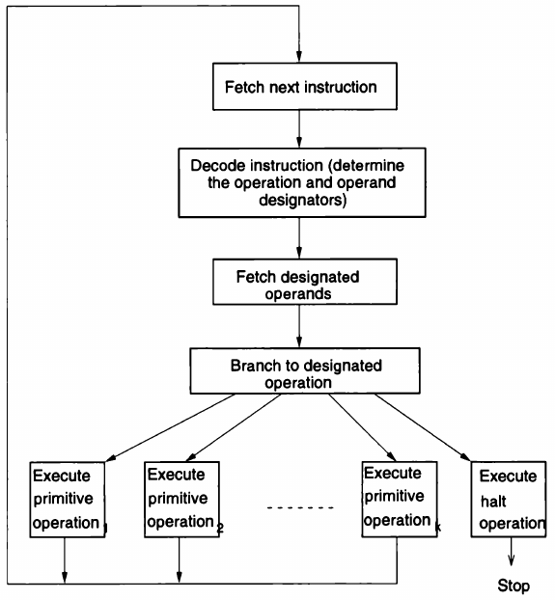
3. Sequence Control
Computer must provide mechanisms for controlling the sequence in which the primitive operations are to be executed.
Dia. : Program interpretation and execution

Slide 31
4. Data Access
Computer must provide mechanisms for controlling the data supplied to each execution of an operation.
Operands values can be accessed from Main memory or Registers. Integer addresses are allocated to the memory locations of Main memory.

Slide 32
5. Storage Management
Computer must provide mechanisms to control the allocation of storage for programs and data.
It takes nanoseconds to access memory within processor (i.e. registers), microseconds to access Main Memory while milliseconds to access external storage.
To balance these speeds appropriately, various storage management facilities are employed.
For speeding up the imbalance between external data access and the central processor, multiprogramming is often used by the operating system.
For speeding up the imbalance between main memory and the central processor, a cache memory is used.

Slide 33
6. Operating Environment
Computer must provide mechanisms for communication with an external environment containing programs and data to be processed.
Operating environment of a computer ordinarily consists of a set of peripheral storage and I/O devices.

Slide 34
Programming Language Qualities
The qualities of a programming language determine its effectiveness, usability, and suitability for different tasks.
1. Readability
Code should be easy to read and understand.
Clear syntax and well-structured constructs enhance comprehension for developers.
2. Simplicity
Language should be simple to learn and use, with minimal unnecessary complexity.

Slide 35
Programming Language Qualities
3. Expressiveness
Language should allow developers to express concepts efficiently and concisely.
4. Efficiency
Language should enable programs to run quickly and use system resources effectively.
5. Portability
Language should allow code to run on different platforms without modification.
6. Scalability
Language should support building applications that scale well as requirements grow.

Slide 36
Programming Language Qualities
7. Reliability
Language should facilitate error detection and correction, leading to fewer bugs.
8. Maintainability
Language should promote writing clean, modular, and reusable code.
Features like functions, classes, and frameworks make it easier to update and maintain.
9. Versatility
A versatile language can be used for various applications, from web development to machine learning.
Example: Python is versatile and widely used in data science, web development, and automation.

Slide 37
Programming Language Qualities
10. Extensibility
Language should support adding new features or extending its capabilities through libraries, plugins, or frameworks.
Example: JavaScript’s ecosystem supports extensions via numerous libraries like React and Node.js.
11. Security
Language should provide features to prevent vulnerabilities such as memory leaks, buffer overflows, and unauthorized access.
Example: Java and Rust offer strong security mechanisms.

Slide 38
Programming Language Qualities
12. Paradigm Support
Support for multiple paradigms (e.g., object-oriented, functional, procedural) increases the language's versatility.
Example: Python and JavaScript support multiple programming paradigms.
13. Robust Error Handling
Language should provide mechanisms to handle errors gracefully.
Example: Try-catch blocks in Java and Python.

Slide 39
Syntax and Semantics
Syntax and semantics are two fundamental aspects of programming languages that work together to define how programs are written and understood.
1. Syntax
Definition: - Syntax refers to the set of rules that define the structure and format of valid statements in a programming language. - It's about how code is written, including keywords, symbols, and punctuation.
E. g. Print in C++
cout << “Hello”; -----Correct Statement
cout << Hello ; ------ Incorrect Statement

Slide 40
2. Semantics
Definition: - Semantics refers to the meaning or behavior of a statement or program. - In other words, behavior of code when its executed
Example
x = 5
y = x + 2
print(y)
Key Points:
Semantic errors occur when the code is syntactically correct but produces unexpected or incorrect results.
These errors are harder to detect because they depend on the program's logic, not just its grammar.

Slide 41
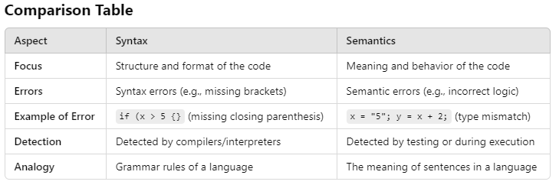

Slide 42
BNF (Backus Naur Form)
ALGOL 60 – Defined developed with set of rules by John Backus
Peter Naur – Editor of ALGOL 60 report
EBNF:- It is metalanguage or set of rules to describe other languages

Slide 43
Key Components of EBNF
Non-terminal Symbols
Represent abstract syntactic elements (e.g., <expression>).
Defined in terms of other non-terminals and terminal symbols.
Terminal Symbols
Represent concrete values (e.g., +, 1, "hello").
Typically enclosed in quotes.
Operators and Syntax:
::= Defined as
* - zero and more instances of previous element
+ - one and more instances of previous element
|: Represents alternative (choice between options).
[]: Denotes optional elements.
{}: Denotes repetition (zero or more occurrences).
() : Groups elements to enforce precedence.

Slide 44
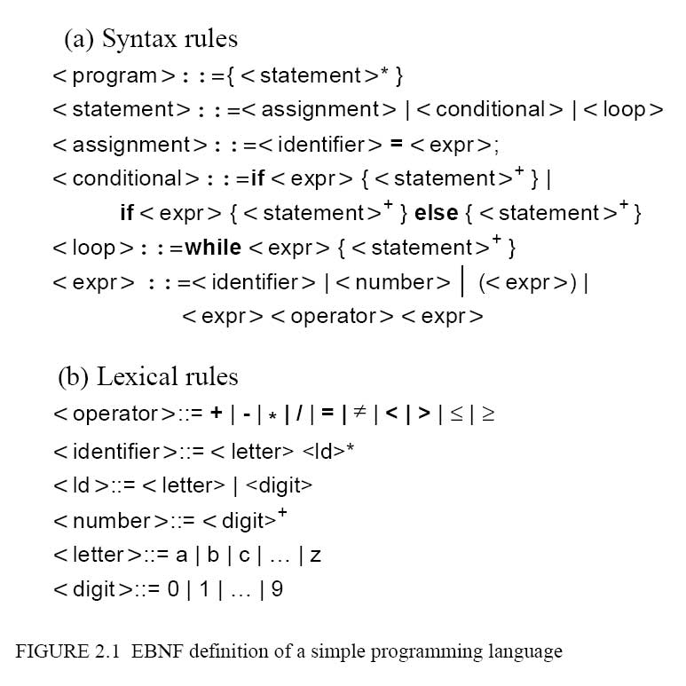

Slide 45
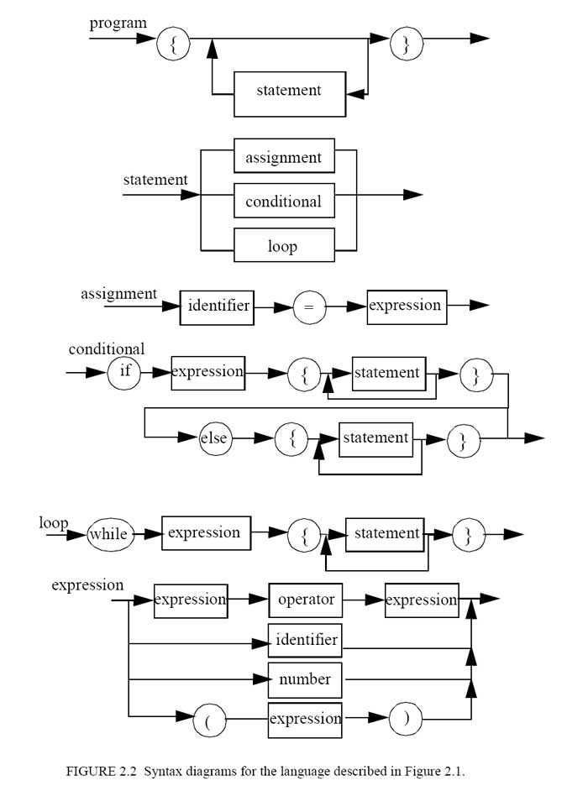

Slide 46
Abstract and Concrete Syntax
Abstract Syntax :-
Logical structure of the code
Purpose:-Used for analysis and processing
Concrete Syntax :-
How the code looks to the programmer
Purpose :- Defines the grammar of the language
While (x!=y) while x<>y do
{ begin
. . . . . .
} end

Slide 47
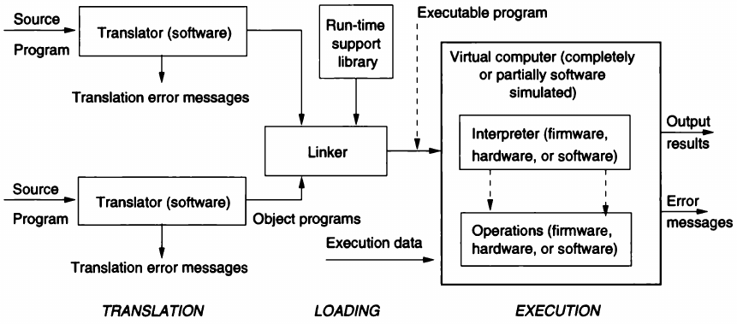
Structure of Language Processing

Slide 48
Concept of Binding
Programs deals with entities, such as variables, routines and statements
Program entity have a certain properties called as “Attributes”
E.g. variable has name, type, storage area where its value is stored
Routines has a name, formal parameters of a certain type, certain parameter passing conventions
Statement has associated actions
Values of attributes must be set before they can be used
Setting the value of attribute is known as binding.
For each entity, attribute information is contained in the repository called a descriptor

Slide 49
Binding
Programming language differ in
No of entities with which they can deal
No of attributes to be bound to entities
In the time at which such bindings occur (binding time)
In the stability of the binding (binding is fixed or modifiable)
Some attributes may be bound at language definition time , others at language implementation time, other at program translation time (means at compile time), and others at program execution time (at run time)

Slide 50
Binding Time
Language Definition Time Binding :-
In most languages Ada, FORTRAN C, C++ the type “integer” is bound at language definition time to its well-known mathematical counterpart i.e it support to integer type
Language Implementation Time Binding :-
In most languages, a set of values to the integer type at language implementation i.e. memory representation
Compile Time (or translation time) :-
In pascal provide the predefined definition of type “integer ” but allows the programmer to redefine it. (i.e. binding can be modified at compile time)

Slide 51
Binding Time
Execution Time:-
In most programming languages variables are bound to a value at execution time and binding can be modified during execution of the program
Binding Type
Static Binding
Dynamic Binding

Slide 52
Variables
Main memory consisting of elementary cells, each of which id identified by an address.
Content of a cell is an encoded representation of value.
Value is mathematical abstraction , it can be read and manipulate
Notion of variable as an abstraction of the notion of memory cell
Variable name as abstraction of address
value
address
name

Slide 53
Variables
Variables has 5 tuples
Name:- string of characters used by program statement to denote the variable
Scope:- range or region up that we can access the variable
Type:- is a variable’s type
l-value:- is the memory location associated with the variable
r-value:- is the encoded value stored in the variable’s location

Slide 54
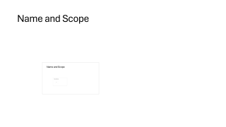

Name and Scope

Slide 55
Type

Slide 56
l-value

Slide 57
r-value

Slide 58
Reference and Unnamed Variables

Slide 59
Routines
Programming language allow a program to be composed of a number of unites, called routines
In most of the language without routines not possible to committing any specific feature
Example of routines => In C , C++ , JAVA => functions
Study of main syntax and semantic features of routines
Means we study the control flow of execution among routines and how binding is established when routine is executed.
In the programming language world, routines usually come in two forms:- procedures and functions

Slide 60
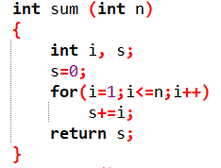
Functions
C, C++ provides the functions

Slide 61
Routines
Like a variables routines have a name, scope, type, l-value and r-value
Name :- introduced in a program by routine declaration
Scope :- declaration point to closing of construct or ending of program
Routing activation :- Achieved through a routine invocation (or routine call) which indicated name of routine and specifies the parameters on which the routine operates
Routine is activated by a call and calling statement must be in the routine’s scope
int result=sum(5); // correct calling
int result=sum(5.3); //Incorrect calling

Slide 62
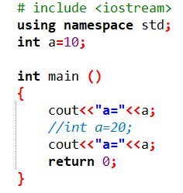
Routines
Besides having their own scope, routine also define the scope for local declaration that are nested in them
As per the programming rule, routines can also refer the nonlocal items. (other than those declare locally)
Non local items => global items

Slide 63
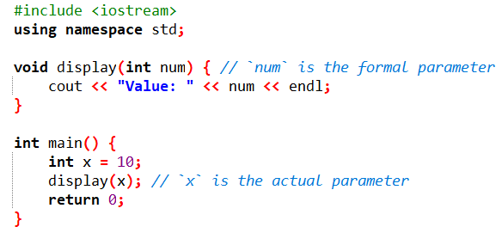
Routine Type
Header of routine defines => routine name, its parameter types, and the type of returned value (if any)
In brief, the routine’s header defines the routine type
Routine call is type correct if it conforms to the corresponding routine type
That means matching the type of formal and actual parameters

Slide 64
Routine’s l-value and r-value
Routine’s l-value is a reference to the memory area which store the routine body (i.e. routine’s executable statements)
Activation causes the execution of routine body, which contribute the r-value that is currently bound to the routine

Slide 65
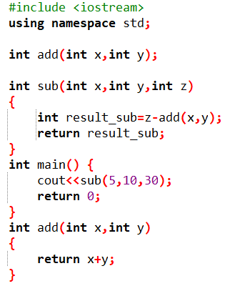
Declaration and Definition of Routine
Routine Declaration=> Routine’s header without specifying the body
Routine Def => Specify both header and body

Slide 66
Routine Instance
Representation of routine during execution is called a routine instance
Routine instance is composed of code segment and activation record
Code Segment:- instructions, content is fixed
Activation Record :- Contain all information necessary to execute the routine, including among other things data objects associated with the local variables of a particular routine instance
And it is changeable.

Slide 67
If routines can activated recursively, a new unit activation can occur before the termination of previous activation of the same unit
All the instances of the same unit are composed of the same code segment but different activation records
Every time unit is activated and binding must be established between an activation record and its code segment.

Slide 68
Generic Routines

